Slide 1
_____________________________________
What Motivates Paternalism?
An Experimental Investigation
_____________________________________
Sandro Ambuehl, B. Douglas Bernheim, and Axel Ockenfels
AER, March 2021

Slide 2
Motivation _____________________________________________
Centuries of normative debate about paternalism (e.g., Locke, Mill)
Paternalism is ubiquitous
Consumer protection, regulation of payday lending and other financial transactions, Undue Influence Doctrine, suicide laws, safety regulations, controlled substances
Paternalistic policies comprise a substantial fraction of the US economy (Currie and Gahvari, 2008)
Scarcity of empirical studies, limited positive understanding of paternalism
Structure of experimental analysis:
Part 1: Basic facts about paternalistic interventions
Part 2: How do people decide what’s good/bad for others?
Part 3: External validity (support for paternalistic policies)

Slide 3
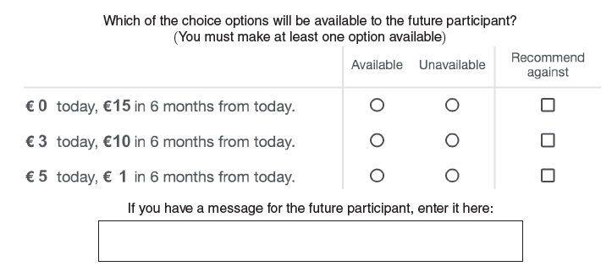
Experimental design _____________________________________________
Main design features
Roles for subjects
Chooser: Selects an action from a choice set (money now vs. money later)
Choice Architect (CA): Decides which options are available to the Chooser
Each Choice Architect is paired with one anonymous Chooser
The typical task:
Some key design features:
No “advice” motive for intervention: Allows for structured and unstructured advice and recommendations
No “convenience” motive for intervention: Chooser rank-orders all options
No selfish motive for intervention: CAs are unaffected by the choice

Slide 4
Experimental design _____________________________________________
Summary of additional design elements
14 rounds of paternalistic decisions – will describe variants as they come up
Other elicitations – will describe as they come up
One randomly selected choice is implemented (strategy method)
Implementation: 303 subjects in the role of Choice Architect recruited at the Cologne Laboratory for Economic Research, Germany

Slide 5
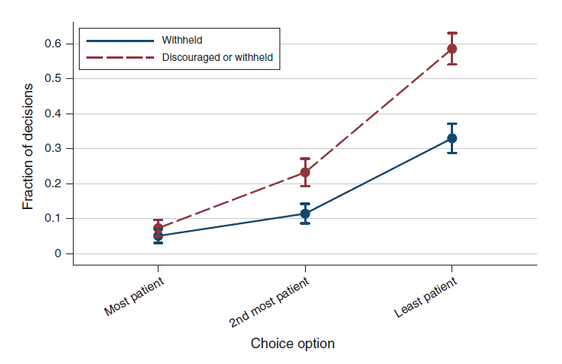
Basic facts about interventions _____________________________________________
Question 1: Do people intervene, and if so, in what way?
YES – by restricting impatient choices

Slide 6
Basic facts about interventions _____________________________________________
Question 2: Are the interventions paternalistic? That is, do people believe they are beneficial
Design feature: we ask Choice Architects whether chosen and exogenous restrictions make Choosers better off. Both incentivized and unincentivized versions.
Overall, around 65% of those imposing restrictions said they made the Chooser better off (around 26% said worse off)
Subjects who imposed restrictions were significantly less likely to say exogenous restrictions were harmful, and significantly more likely to say they were helpful
Generally corroborated by incentivized versions
So generally YES, they do

Slide 7
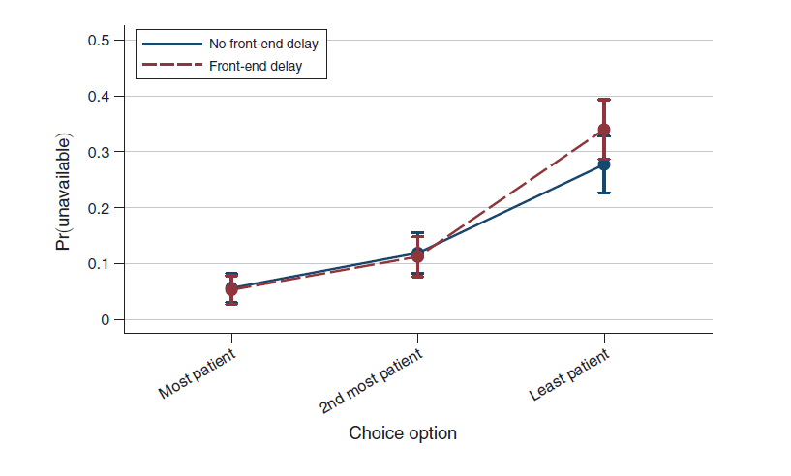
Basic facts about interventions _____________________________________________
Question 3: Do people intervene to correct perceived “present bias” (the reason commonly envisioned by behavioral economists)?
Design feature: For one of the paternalistic decisions, we add “front end delay,” which should neutralize present bias, and remove this motive for intervention.
NO – with front-end delay, there is slightly more intervention, not less

Slide 8
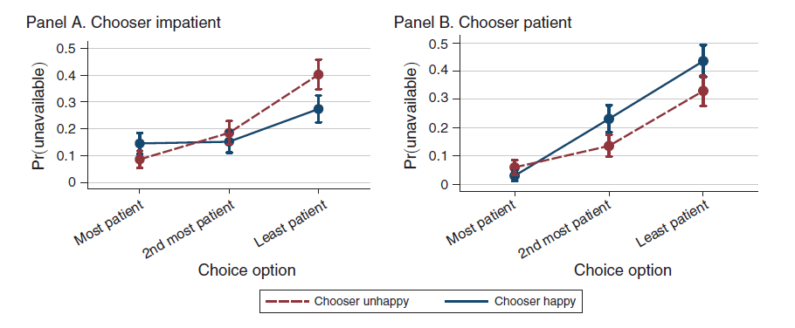
Basic facts about interventions _____________________________________________
Question 4: Do interventions depend on knowledge about the Chooser’s inclinations and evaluations? Alternative: CAs simply impose their own inflexible judgments.
Design feature: For some paternalistic decisions, we provide information about the Chooser’s patience (high low), as well as happiness with their patience
YES – they respond to the Chooser’s degree of patience, and to the Chooser’s happiness with their degree of patience

Slide 9
How do people decide what is good or bad for others? _____________________________________________
Remember that CAs do think Chooser’s inclinations and subjective experiences are relevant. But where does this information normally come from?
A natural possibility: people project the inclinations and subjective experiences of others based on themselves.
“As we have no immediate experience of what other men feel, we can form no idea of the manner in which they are affected, but by conceiving what we ourselves should feel in the like situation.” Adam Smith, The Theory of Moral Sentiments
But what do they project? Their values, susceptibility to mistakes, or both?
A mistakes projective paternalist assumes others tend to share her susceptibility to error, and tries to help others avoid choices she herself would like to reject, but often doesn’t
An ideals-projective paternalist assumes her own preferences are relevant for others, either because she thinks they share her values or because hers are more valid
A conventional behavioral welfarist has accurate beliefs about others, unrelated to her own preferences

Slide 10
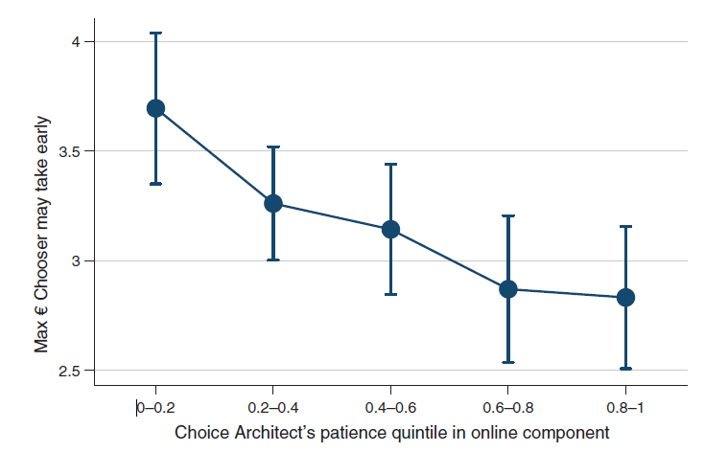
How do people decide what is good or bad for others? _____________________________________________
Question 5: Are people mistakes-projective, ideals-projective, or neither?
Proposition: Through the mistakes-projective (ideals-projective) mechanism, the optimal mandate and optimal surrogate choice are decreasing (increasing) in the CA’s own selection. (No relation for conventional behavioral welfarist.)
Design elements: elicit CA’s time preferences (avoiding cross-contamination), include surrogate choices
Implies ideals-projection, not mistakes-projection
Explains earlier finding on front-end delay
Similar pattern for surrogate choices

Slide 11
How do people decide what is good or bad for others? _____________________________________________
Question 6: Are interventions misguided?
Answer doesn’t follow from previous result, because an ideals-projective paternalist may have correct beliefs about others’ choices, but may decompose those choices into and ideal and mistaken component based on their own subjective values.
Design element: elicit beliefs about what Choosers will select if unrestricted.
Regressions show that:
CAs who choose more patiently for themselves think Choosers will be more patient (False Consensus Effect)
These beliefs matter: CAs who think Choosers are more patient impose more restrictive mandates
Therefore, more patient CAs impose restrictions what bind for more Choosers
However, patient and impatience CAs believe their chosen restrictions will affect the same fraction of Choosers

Slide 12
External validity _____________________________________________
Question 7: Are the results applicable to real-world policy preferences?
Design elements:
Subjects expressed support for or opposition to four real-world paternalistic policies for a neighboring country (Switzerland): taxes on sugary drinks, alcohol, and tobacco, and restrictions on short-term high-interest loans.
Subjects indicated their consumption/use of these products
Support for restrictions is in all cases correlated with more restrictive mandates in the experiment.
Support for each policy exhibits the characteristic correlation of ideals-projective paternalism: greater use implies lower support for the restrictions (on others in a neighboring country).

